Slide 1
WELCOME!

Slide 3
What is in this Slide Deck?
The Scope 3 Peer Group (in particular, the 150 that participated in the January 2024 Strategy Day) have compiled their challenges & advice into this deck.
We used AI to summarise many of the questions/challenges.
You can use this to share with your organisation as a strong, fresh guide to what you need to be asking & tackling.
Hope it’s useful!
Ollie Hurrey
Founder & Chair
Scope 3 Peer Group
www.scope3peergroup.com

Slide 4
What should you do next?
Download all the slides & templates that other Scope 3 Peer Group members have provided in this Dropbox folder (contact Oliver if you have any issues with the folder and need something sent another way). More content will be added before the end of February.
Make sure you are attending the next virtual Scope 3 Peer Group meeting on the 28 February. Click HERE to register. We will discuss the outputs and next steps.
3. Join us and/or invite colleagues to our next in-person meetings in Chicago on 26-27 June OR reserve your seat ASAP for 29-30 January in London. Those that book now and attended this year will get the biggest discount and priority.
4. Take the free Benchmark again ASAP: www.scope3benchmark.com and keep an eye on www.scope3peergroup.com. Get in touch with Oliver if you have any questions at all. Let’s make much faster and more confident progress in 2024!

Slide 5
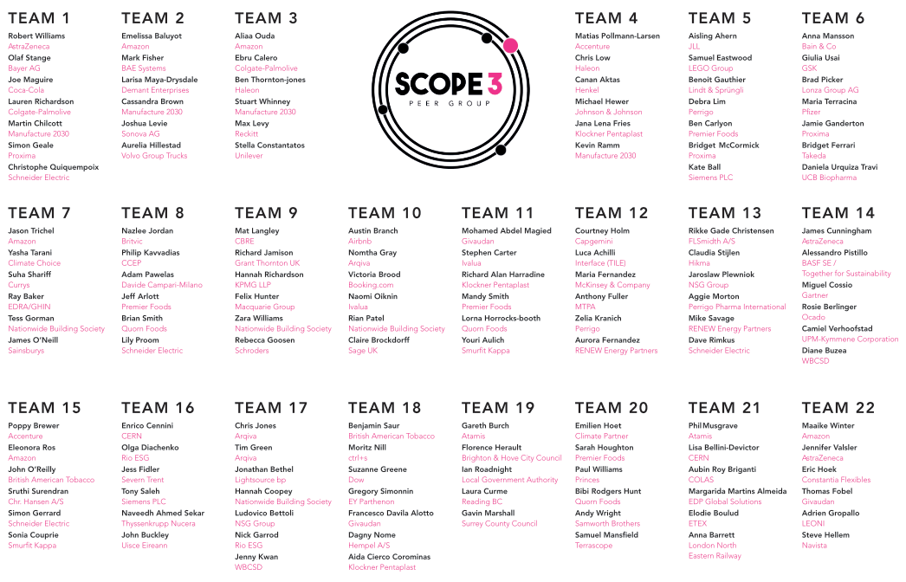
WELCOME!
Who was there?

Slide 6
The Summary of Everyone’s Scope 3 Challenges
1. Scope 3 Integration and Engagement:
Integrating scope 3 in sourcing decisions despite unreliability
Challenges in operationalizing the Scope 3 strategy
Scaling up scope 3 engagement and reduction tracking
Transforming procurement functions to tackle scope 3
2. Supplier Engagement and Collaboration:
Difficulty in engaging small suppliers
Ensuring engagement of low-maturity suppliers on sustainability
Strategies for influencing suppliers to reduce GHG emissions
3. Data Management and Accuracy:
Validation of primary data
Challenges with data disclosure and action plans of suppliers
Lack of accurate and meaningful data
4. Decarbonization Strategies:
Decarbonizing ingredients and engaging the supply chain
Decarbonization of supply chain facilities
5. Tools, Resources, and Standardization:
Need for integrated tools and collaboration toolsets
Assessing, comparing, and benchmarking existing solution providers
Identifying quick wins to decarbonize scope 3

Slide 7
The Key Success Factors to a Scope 3 Strategy
# 1 Have a strategic scope 3 goal for the organisation - with clear metrics for tracking progress and embed it within procurement's goals
# 2 Cascade the strategic scope 3 goal into your business units and internal clients' goals
# 3 Ensure there is sustainability resource inside procurement and buyer responsibility for their suppliers’ climate performance
# 4 Choose a measure with suppliers that is meaningful to them and your procurement team
# 5 Aim for primary, activity-based data that is trustworthy and gives you actionable insights
# 6 Build understanding of the actions the business must take on carbon, not just learning what carbon is
# 7 Supplier dialogue (not monologue) and collaboration (i.e. doing) with all meaningful suppliers and with intent to cascade to multiple tiers
# 8 Prioritise the quality of your supplier engagement and good supplier relationship management principles
# 9 Make your asks of suppliers specific, measurable, achievable, relevant and time-bound. Make the 1st step achievable for suppliers to maximise engagement
# 10 Balance the importance of bold, achievable action and necessary measurement. One without the other wastes a lot of time that we don't have.

Slide 8
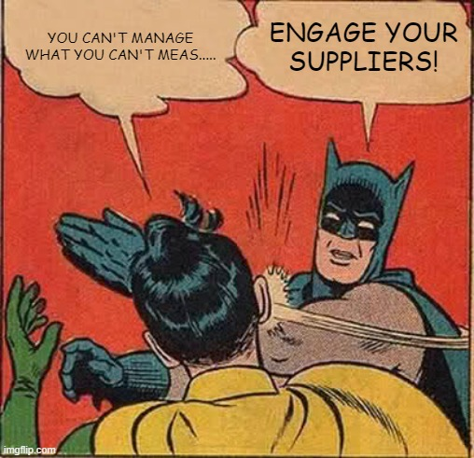
Your Supplier Engagement Questions
1. How can you support smaller / less mature suppliers?
2. How do you best segment suppliers & track progress?
3. How do you efficiently engage suppliers at scale and help implement tangible quick-win reduction actions?
4. What successful incentives and levers influence suppliers to engage & scale decarbonization efforts?
5. How to integrate sustainability goals into procurement processes, and what key metrics are considered essential for measuring success?

Slide 9
Your Supplier Engagement Questions
1. How can you support smaller / less mature suppliers?
2. How do you best segment suppliers & track progress?
3. How do you efficiently engage suppliers at scale and help implement tangible quick-win reduction actions?
4. What successful incentives and levers influence suppliers to engage & scale decarbonization efforts?
5. How to integrate sustainability goals into procurement processes, and what key metrics are considered essential for measuring success?

Slide 10
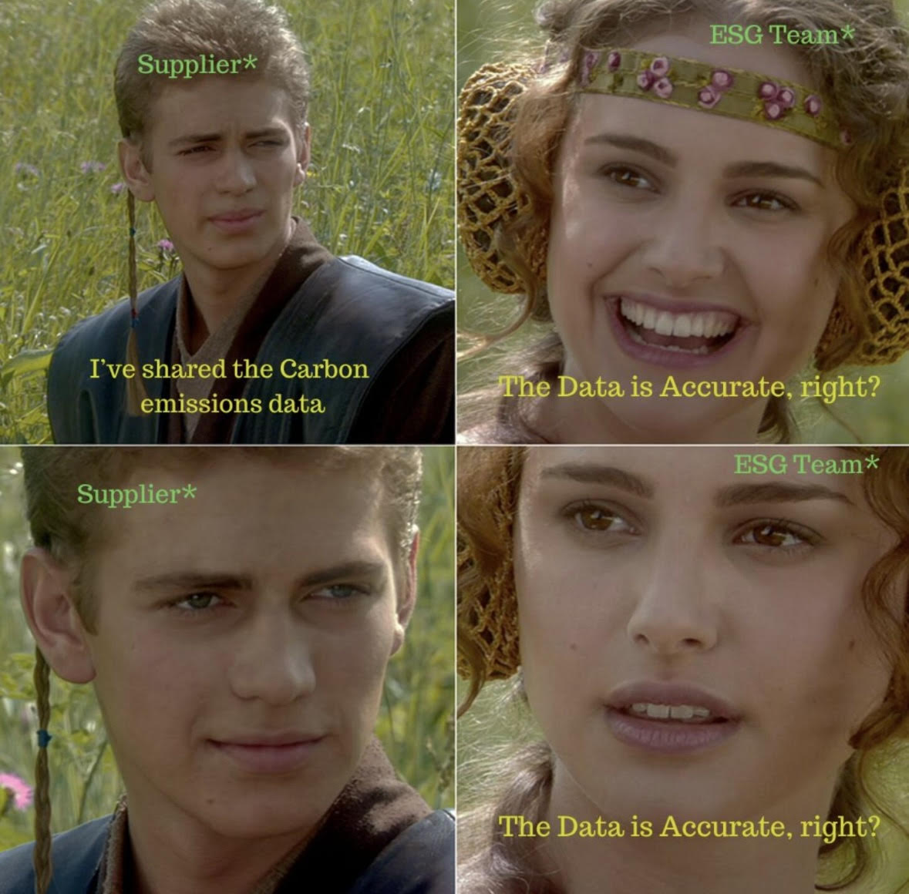
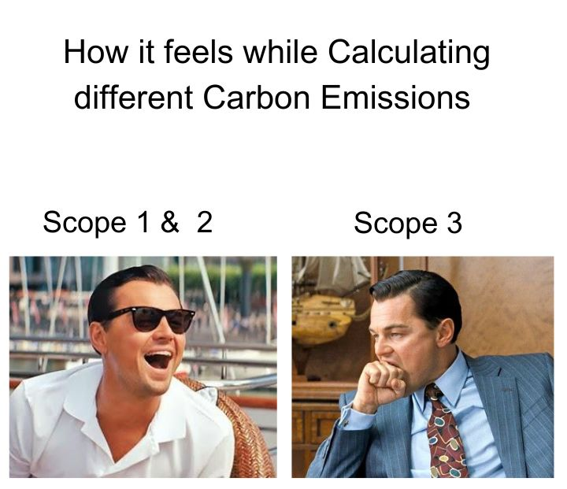
Your Data Strategy Questions
1. How do you address data standardization and disclosures by key suppliers and what methods are employed to measure data quality?
2. How do you transition from spend-based & secondary to primary data from suppliers, especially when suppliers don’t have product- level data?
3. What technologies or platforms are you using for collecting and validating data?
4. How do you balance breadth vs depth in data collection?
5. How do you create a credible decarbonization roadmap to meet SBTI targets, and how is thinking on data for reporting vs decision making evolving?

Slide 11
Your Product Carbon Footprint Questions
1. How do you intend to tackle the calculation and accounting of PCFs, and what can be put in place to ensure accuracy and reliability?
2. How do you verify and compare PCFs from various sources, considering evolving baselines?
3. How do you embed PCFs into procurement processes and decision-making for purchases?
4. How do you validate supplier-specific emission factors, ensure comparability, and convince suppliers to absorb reporting and third-party verification costs?
5. What specific actions can be taken beyond reporting with PCF data? How do you commit to and detail future footprint reductions?

Slide 12
Your Advice for Those Looking for Solutions
1. Digital Compliance and Protocols:
Choose a solution that is digitally compliant with ESRD, SBTI, and CDP.
2. User-Friendly Scalability:
Prioritize solutions that are user-friendly and scalable, catering to both sustainability experts and buyers, allowing for operationalization of CO2 reduction targets.
3. Emissions Monitoring & Tracking:
Select a solution that effectively monitors but also crucially enables tracking of emissions reduction activity, ideally both sustainability and cost impact, thus providing insights crucial for strategic decision-making for both buyer AND supplier
4. Supplier Support Functionality:
Opt for a strong supplier support functionality, with seamless integration into existing procurement spend data systems and offering automated validation of primary data.
5. Strategic Focus on Scope 3 Hot Spots:
Understand Scope 3 hot spots and key supply base areas to establish a strategy focused on high-impact emissions reduction

Slide 13
Your Advice for Those Looking for Solutions
6. Top Management Endorsement:
Ensure top management endorsement for the chosen solution, as it is crucial for building, validating, and implementing the sustainability strategy.
7. Effective Supplier Engagement:
Emphasize strong guidance to suppliers, including incentives and penalties, and be prepared to exit poor-performing suppliers to drive effective engagement and reduction.
8. Reference Checking:
Obtain strong references from peers that have successfully implemented and benefited from the chosen solution.
9. Clear Prioritization:
Clearly define and prioritize your highest priority, solving for that with a partner who can incorporate additional requirements into their development roadmap.
10. Integration and Flexibility:
Select solutions that can integrate with existing systems and processes, focusing on primary data, tech roadmaps, education, supplier engagement, and collaboration.

Slide 14
The Love Letter to Scope 3 Solution Providers
1. Interoperability and Integration:
Emphasize interoperability between systems. Offer to seamlessly integrate with our existing data structures/lakes to reduce reporting burdens on suppliers.
2. Align with Standards and Initiatives:
Ensure alignment with leading standards and industry-specific initiatives to enhance credibility and consistency in emissions reporting.
3. Dual-Team Functionality:
Cater for both Sustainability & Procurement teams, understanding their distinct priorities and metrics while providing a collaborative platform for joint work.
4. Supplier Support Tools:
Offer support tools beyond data capture software to assist suppliers once on the platform, addressing their needs and challenges related to emissions reporting.
5. Simplicity and Harmonization:
Prioritize it in solutions, streamlining data requests, and reduce survey fatigue to make the adoption process smoother for both companies and suppliers.

Slide 15
The Love Letter to Scope 3 Solution Providers
6. Flexibility and Customization:
Be flexible with tools, allowing integration with existing tools rather than imposing complete replacements, and provide customization based on specific sector needs.
7. Transparency and Education:
Clearly communicate offerings and functionalities, avoiding unnecessary features. Actively share expertise and educate users to foster better understanding and utilization.
8. Ease of Use for Suppliers:
Focus on solutions that are less demanding for suppliers, leveraging data intelligence while ensuring information goes beyond predictive scores to include specific KPIs.
9. Collaboration and Standardization:
Collaborate with other solutions to drive integration and work towards standardization and common terms/definitions within the industry.
10. Data Transparency and Assurance:
Be transparent on emission factors and methodologies used. Offer self-service functions for remapping emission factors. Highlight whether data is externally assured or verified.

Slide 16
The 2024 Scope 3 Peer Group Tools Review
The Scope 3 Peer Group asks its members once per year about the noisy landscape of scope 3 tools in the market. Collectively we’ve seen & heard thousands of demos, pitches and promises.
We compile all this opinion and insight into this document and make it available to anyone, anywhere for free. A huge thank you to Miguel Cossio for his support! The forthcoming Scope 3 Podcast will take a different look at the philosophies and visions of many of the solutions’ founders.
We hope it helps you make faster & more confident decisions. But make sure you talk directly to your most immediate peers as well, first.
Ollie Hurrey
Founder & Chair
Scope 3 Peer Group
www.scope3peergroup.com

Slide 17
Respondent Demographics Primary Workplace Location
Single response
USA
& CAN 21%
Europe 71%
APAC 5%
Latin America 2%
n = 122, Scope 3 Peer Group Members
Q1) Where is your organization’s corporate headquarters or main office located?
Source: Scope 3 Peer Group. Digital Solutions Landscape and Adoption Survey, Dec 2023

Slide 18
Respondent Demographics Primary Industry
Single response
n = 122, Scope 3 Peer Group Members
Q2) What is your company’s primary industry classification?
Source: Scope 3 Peer Group. Digital Solutions Landscape and Adoption Survey, Dec 2023

Slide 19
Respondent Demographics Manufacturing Sub-Industry
Single response
n = 58, Scope 3 Peer Group Members
Q2) What is your company’s primary industry classification? Manufacturing sub-industry
Source: Scope 3 Peer Group. Digital Solutions Landscape and Adoption Survey, Dec 2023

Slide 20
Respondent Demographics Annual Revenue
Single response
n = 117, Scope 3 Peer Group Members
Q3) Which of the following ranges best represents your company’s enterprise-wide annual revenue for fiscal year 2022?
Source: Scope 3 Peer Group. Digital Solutions Landscape and Adoption Survey, Dec 2023

Slide 21
Primary Focus of Scope 3 Program Corporate Value Chain vs Product Lifecycle
Single response
n = 105, Scope 3 Peer Group Members
Q4) What type of carbon emissions is your company primarily focused on as part of its Scope 3 program?
Source: Scope 3 Peer Group. Digital Solutions Landscape and Adoption Survey, Dec 2023

Slide 22
Type of Spend Being Addressed
Multiple Selection
Direct
Indirect
38%
6%
17%
20%
16%
1%
Logistics
1%
n = 105, Scope 3 Peer Group Members
Q5) What type of spend is your company primarily focused on as part of its Scope 3 decarbonization program?
Source: Scope 3 Peer Group. Digital Solutions Landscape and Adoption Survey, Dec 2023

Slide 23
Primary Outcome for Pursuing Scope 3 Program
Single response
n = 101, Scope 3 Peer Group Members
Q6) What is the current, primary outcome your company is pursuing as part of its Scope 3 decarbonization program?
Source: Scope 3 Peer Group. Digital Solutions Landscape and Adoption Survey, Dec 2023

Slide 24
Current Adoption of Digital Solutions for Scope 3
Single response
n = 100, Scope 3 Peer Group Members
Q7) What statement best describes the current adoption of digital solutions at your organization to support your Scope 3 program?
Source: Scope 3 Peer Group. Digital Solutions Landscape and Adoption Survey, Dec 2023

Slide 25
Timeline for Selecting a Digital Solution
Single response
n = 39, Scope 3 Peer Group Members
Q8) How soon are you expecting to finalize your decision and select a digital solution to support your Scope 3 program?
Source: Scope 3 Peer Group. Digital Solutions Landscape and Adoption Survey, Dec 2023

Slide 26
Top Challenges Companies Face When Selecting a Solution
Top 3 Summary
n = 39, Scope 3 Peer Group Members
Q9) What are the top 3 challenges your company is currently facing when selecting a digital solution to support your Scope 3 strategy?
Source: Scope 3 Peer Group. Digital Solutions Landscape and Adoption Survey, Dec 2023
Notes:
Slide No: 25-Bar Chart

Slide 27
In-House Development vs Third-Party Solutions
Single response
n = 82, Scope 3 Peer Group Members
Q10) Are you using (or expecting to use) digital solutions offered by a third party or developed in-house?
Source: Scope 3 Peer Group. Digital Solutions Landscape and Adoption Survey, Dec 2023

Slide 28
Importance of Using a Digital Solution to Deliver on Scope 3 Goals
Single response
n = 78, Scope 3 Peer Group Members
Q11) In your opinion, how important is the use of a digital solution to help you deliver on your company’s Scope 3 decarbonization goals?
Source: Scope 3 Peer Group. Digital Solutions Landscape and Adoption Survey, Dec 2023

Slide 29
How Companies Identify and Select Digital Solutions
Single response
n = 78, Scope 3 Peer Group Members
Q12) As you seek to identify and select digital solutions to support your Scope 3 program, what statement best describes how you approach this process?
Source: Scope 3 Peer Group. Digital Solutions Landscape and Adoption Survey, Dec 2023

Slide 30
Multiple Tools Might Be Needed
Single response (Q13), Multiple Selection (Q14)
n varies, Scope 3 Peer Group Members
Q13) How many digital solutions are you currently using (or expecting to use) to support your Scope 3 program?
Q14) Why are you using (or expecting to use) multiple digital solutions to support your Scope 3 program?
Source: Scope 3 Peer Group. Digital Solutions Landscape and Adoption Survey, Dec 2023

Slide 31
Types of Solutions Being Used or Considered
Multiple Selection
n = 78, Scope 3 Peer Group Members
Q15) What types of digital solutions are you currently using (or expecting to use) to support your Scope 3 program?
Source: Scope 3 Peer Group. Digital Solutions Landscape and Adoption Survey, Dec 2023

Slide 32
Market Voice: Vendors Being Used or Under Consideration
# of Mentions | Vendor Name
1 | Achilles | Expect AI | Expect AI | Metrio | Metrio | SupplyPilot | UL 360
 | AllocNow | Go Supply | Go Supply | Optera | Optera | sustain.life | Workiva
 | Avarni | Greenly | Greenly | Sievo CO2 Analytics | Sievo CO2 Analytics | Terrascope | Worldfavor
 | CarbonFact | Impacti | Impacti | Supplier I/O Impak | Supplier I/O Impak | Traace | Zeigo Activate
 | Climate Choice | Intelex | Intelex
2 | Ecochain | Microsoft Cloud for Sustainability | Microsoft Cloud for Sustainability
 | Greenstone | Responsibly | Responsibly
 | IBM Envizi | Salesforce Net Zero Cloud | Salesforce Net Zero Cloud
 | IntegrityNext
3 | Carbmee | Normative | Normative
 | Ecotransit | Supplyshift | Supplyshift
 | Equipoise | Sweep | Sweep
4 | EmitWise
 | IValua - Environmental Impact Center
 | siGreen - Siemens
5 to 10 | CO2 AI
 | Ctrl+S / Matter+S
 | Watershed
10 to 20 | CDP Supply Chain
 | Ecovadis - Carbon Action Module
 | M2030 - Manufacture 2030
 | Sphera
n = 75, Scope 3 Peer Group Members
Q16) Please indicate the names of the digital solution(s) you are currently using - or have identified as a potential good fit - to enable your Scope 3 program
Source: Scope 3 Peer Group. Digital Solutions Landscape and Adoption Survey, Dec 2023

Slide 33
Market Voice: Enabling Specific Outcomes by Ranking
 | Measure | Manage | Reduce | Report
Vendor Name | (n=56) | (n=44) | (n=44) | (n=44)
CDP Supply Chain
Ctrl+S / Matter+S
CO2 AI
Carbmee
Avarni
Ecovadis - Carbon Action Module
M2030 - Manufacture 2030
Ecochain
EmitWise
Equipoise - Carbon module
Climate Choice
Carbon intelligence
Ecotransit
Greenly
Sphera
Normative
Watershed
Ecodesk Horizon
ESG Flo
 | Measure | Manage | Reduce | Report
Vendor Name | (n=56) | (n=44) | (n=44) | (n=44)
Expect AI
Figbytes
FutureProof
IValua - Environmental Impact Center
Sweep
Greenstone
Metrio
Microsoft Cloud for Sustainability
Optera
siGreen - Siemens
Klima.metrix
Novata
Supplyshift
Sievo CO2 Analytics
Zeigo Activate
Responsibly
Salesforce Sustainability/Net Zero Cloud
sustain.life
Workiva
75th Percentile
50th Percentile
25th Percentile
No Input
N varies, Scope 3 Peer Group Members
Q17-20) For the vendors you selected, please tell us if you feel they do a good job at any of the following activities to Measure/Manage/Reduce/Report emissions and data for your Scope 3 program
Source: Scope 3 Peer Group. Digital Solutions Landscape and Adoption Survey, Dec 2023

Slide 34
Market Voice – Capabilities Assessed
Collect & Measure
Manage
Reduce
Report
Baselining and hotspot analysis
Collect supplier primary data
Carbon calculator for suppliers
Collect allocated emissions beyond enterprise level
Glidepaths to make projections
Data quality indicator
Use of internal carbon pricing
Highlight priority areas where to focus
Share with suppliers curated list of projects to decarbonize
Supplier capability-building
Track decarbonization projects suppliers are implementing
Export/embed data into other enterprise solutions
Smart workflows to create standard-align disclosures
Provide access to external stakeholders to assess progress
Data is auditable

Slide 35
Top Solution Capabilities Needed Collect and Measure
Top 3 Summary
n = 65, Scope 3 Peer Group Members
Q21) What are the top 3 capabilities you need in a digital solution to help you COLLECT & MEASURE relevant data for your Scope 3 program?
Source: Scope 3 Peer Group. Digital Solutions Landscape and Adoption Survey, Dec 2023

Slide 36
Top Solution Capabilities Needed Manage
Top 3 Summary
n = 65, Scope 3 Peer Group Members
Q22) What are the top 3 capabilities you need in a digital solution to help you MANAGE your Scope 3 emissions program?
Source: Scope 3 Peer Group. Digital Solutions Landscape and Adoption Survey, Dec 2023

Slide 37
Top Solution Capabilities Needed Reduce
Top 3 Summary
n = 65, Scope 3 Peer Group Members
Q23) What are the top 3 capabilities you need in a digital solution to help you REDUCE your Scope 3 emissions?
Source: Scope 3 Peer Group. Digital Solutions Landscape and Adoption Survey, Dec 2023

Slide 38
Top Solution Capabilities Needed Report
Top 3 Summary
n = 65, Scope 3 Peer Group Members
Q24) What are the top 3 capabilities you need in a digital solution to help you REPORT relevant data of your Scope 3 program?
Source: Scope 3 Peer Group. Digital Solutions Landscape and Adoption Survey, Dec 2023

Slide 39
Most Important Factors When Selecting a Solution
Top 3 Summary
n = 63, Scope 3 Peer Group Members
Q25) What are the top 3 capabilities you need in a digital solution to help you REPORT relevant data of your Scope 3 program?
Source: Scope 3 Peer Group. Digital Solutions Landscape and Adoption Survey, Dec 2023

Slide 40
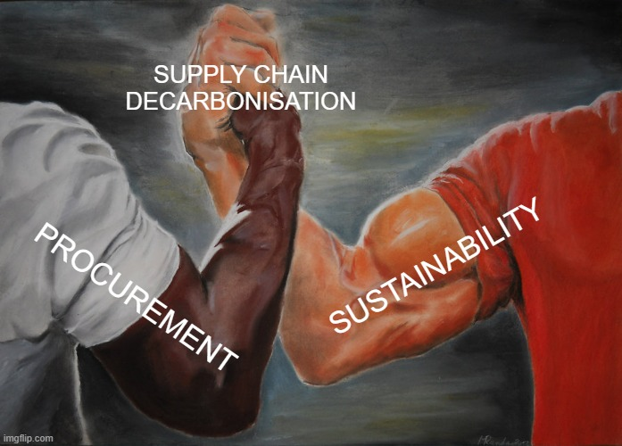
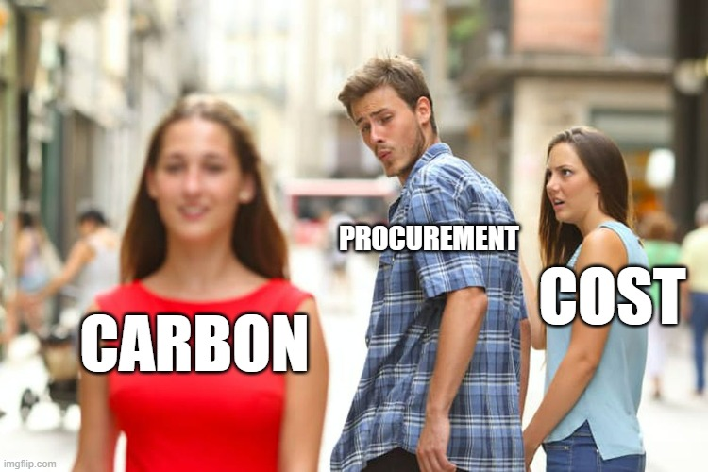
Your Procurement Engagement Questions
1. How do you define and communicate the roles of Procurement and Sustainability, especially when it's not seen as a priority, and secure budget?
2. What is the size and structure of your procurement & sustainability teams and resource?
3. What tools and enablers are utilized in procurement, and how do you influence suppliers, when you have less leverage?
4. How do you credibly embed sustainability into procurement processes and help them own emissions savings alongside cost?
5. What incentives are in place for buyers? How are you planning to integrate carbon into procurement decisions? What metrics are incorporated into supplier selection processes?

Slide 41
Your Procurement Engagement Questions
1. How do you define and communicate the roles of Procurement and Sustainability, especially when it's not seen as a priority, and secure budget?
2. What is the size and structure of your procurement & sustainability teams and resource?
3. What tools and enablers are utilized in procurement, and how do you influence suppliers, when you have less leverage?
4. How do you credibly embed sustainability into procurement processes and help them own emissions savings alongside cost?
5. What incentives are in place for buyers? How are you planning to integrate carbon into procurement decisions? What metrics are incorporated into supplier selection processes?

Slide 42
What should you do next?
Download all the slides & templates that other Scope 3 Peer Group members have provided in this Dropbox folder (contact Oliver if you have any issues with the folder and need something sent another way). More content will be added before the end of February.
Make sure you are attending the next virtual Scope 3 Peer Group meeting on the 28 February. Click HERE to register. We will discuss the outputs and next steps.
3. Join us and/or invite colleagues to our next in-person meetings in Chicago on 26-27 June OR reserve your seat ASAP for 29-30 January in London. Those that book now and attended this year will get the biggest discount and priority.
4. Take the free Benchmark again ASAP: www.scope3benchmark.com and keep an eye on www.scope3peergroup.com. Get in touch with Oliver if you have any questions at all. Let’s make much faster and more confident progress in 2024!

