Slide 1
Supplier engagement
Scope 3 Peer Group Strategy Day 2024

Slide 2
The zero-emission mining process
The zero-emission cement plant
Commercially competitive with a minimised environmental footprint
Commercially competitive with cement quality guaranteed
Zero water waste
Zero emissions
Zero energy waste
Zero emissions
100% fuel substitution
Zero waste
Notes:
MissionZero is our sustainability commitment enabling customers to move towards zero emissions in 2030.
By 2030 we will engineer a cement plant with zero emissions, alternative fuels and zero waste.
And a zero emissions mine site with zero water discharge, zero CO2, and zero energy waste.

Slide 3
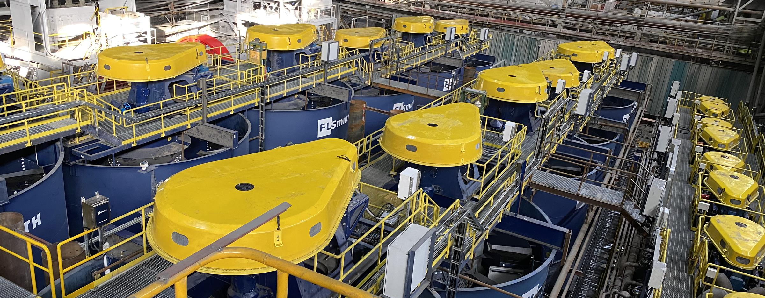
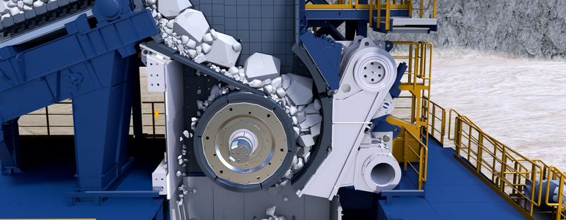
Examples of products

Slide 4
Minimising environmental impact across the value chain
Upstream
We encourage environmental action across our supply chain
Our operations
We are reducing the environmental
impact of our own operations
Downstream
We are reducing emissions from
the use of our products
<1%*
<1%*
>99%*
30%
of spend with suppliers who have
science-based targets by 2025
Carbon neutral
By 2030
56%
reduction in CO₂e per order intake from use of sold products by 2030 from 2019 levels
7.7%
2.8%-point
Increase from 2021
36,767
tCO₂e
16% ahead of 2022 target
5,310
tCO₂e/DKKm (order intake)
50% of 2019 baseline
49% better than 2021
Our 2022
performance
*of total value-chain emissions
Notes:
Mining and cement operations have a significant impact on the environment – together contributing approximately 10% of global CO₂ emissions. The use of our products by our customers generates around 99% of greenhouse gas emissions. This is why our MissionZero programme is so important and has so much potential. It focuses on helping customers to reduce their emissions – which will therefore help reduce global CO₂ emissions.
We also work with our suppliers to help them reduce their environmental impact – and we are reducing the impact of our own operations.
In each of those areas, we have set specific goals, which are approved by the Science-Based Targets initiative.
We are making good progress towards those targets – and these targets are top of mind in our business today.

Slide 5
The task in Procurement We need to know what are suppliers are doing in relation to climate targets
We need to ask suppliers, so we know
which suppliers to support
Available public information
from Science Based Targets initiative
(SBTi) website
FLSmidth target: 30% of spend
Unknown
Not started
Have target (not SBT)
Plan to set SBT
Committed
Target Set
Plans to measure
Measure CO2
Plan to set target

Slide 6
SBT Programme 2023 - supplier approaches
Dedicated support: Top spend suppliers that need extra support to get started is high priority and get support from project manager
Ad hoc support: Suppliers that have started already or that based on limited input can continue increase maturity on climate will get ad hoc support as needed.
Support is through meetings with FLSmidth Supply Chain Sustainability function facilitated by GCMs/RSMs.
High
Dedicated support to get started
Ad hoc support to ensure progress continues
Track from SBT website
Global Category Manager responsible for suppliers are contacted to identify where further support relevant
Spend
Category Management: GCMs /RSMs reach out to suppliers through regular meetings. Supply Chain Sustainability function is involved as needed.
Track if on SBT website
Low
Low/unknown
Climate action maturity
High

Slide 7
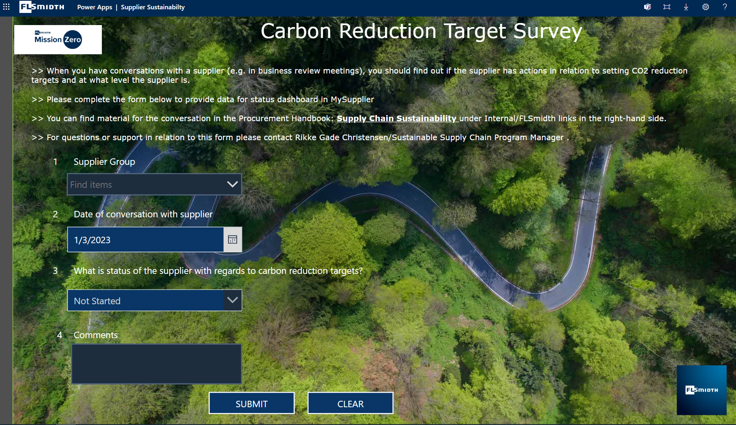
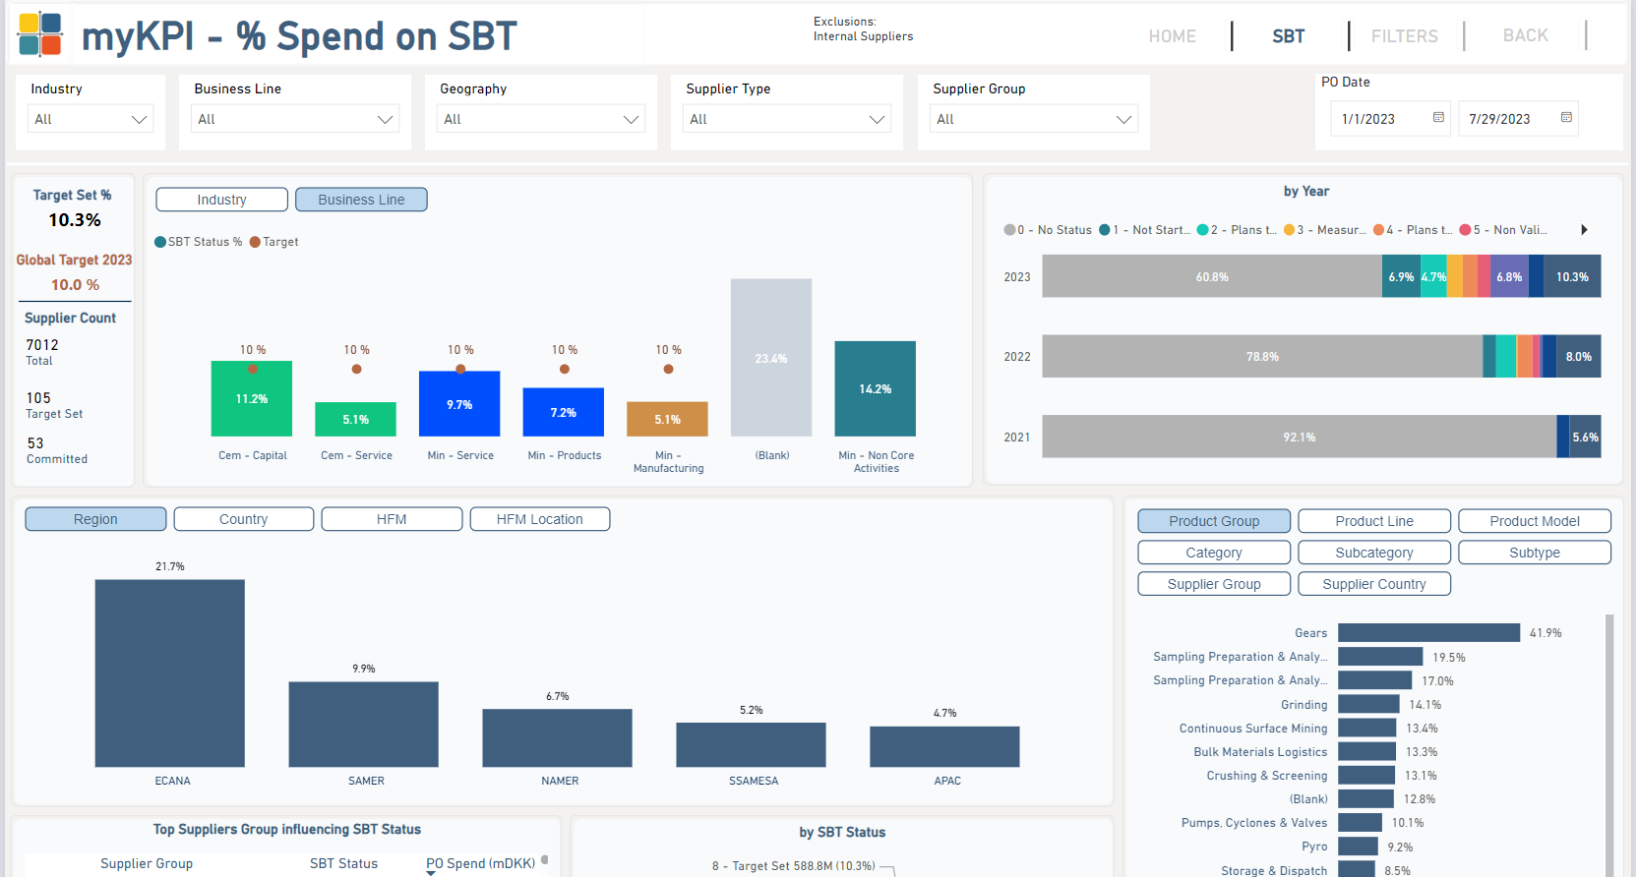
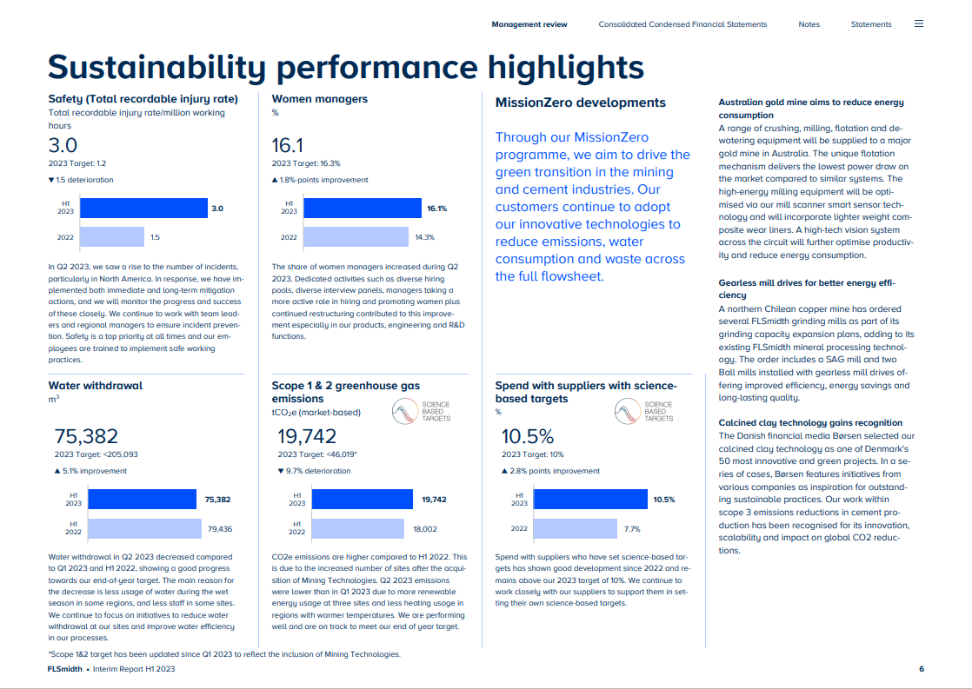
SBT dashboard – for transparency and communication

Slide 8
Guidance to suppliers
Guidance material is available on SharePoint – Procurement Handbook

Slide 9
Key points to share
Remember it is all about people and relations
Building capacity is key but it takes time and a lot of repetition
Visible data has been key to communicate and for internal awareness

Slide 10
Thank you

