Slide 1

Engaging suppliers for scope 3 reductions
Dagny Nome
Procurement Sustainability
Manager
Scope 3 Strategy Day
London, UK
23rd January 2024

Slide 2
Hempel is a global coatings company
Sustainability – Foundation course
Our purpose is to shape a brighter future with sustainable coating solutions

Slide 3
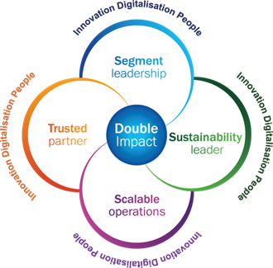

Procurement: Three sustainability must win battles
Achieve Hempel’s ambitions for sustainability leadership
Realize the boldest climate ambitions in our industry
Comply with the transition from soft to hard law on sustainability
Focus on value chain transparency, due diligence process and reporting
Main upcoming EU legislation
Corporate Due Diligence Act (CSDD)
Corporate Sustainability Reporting Directive (CSRD)
..but also a myriad of national legislations
Scope 1+2: 90% reductions
Scope 3: 50% absolute reductions

Slide 4
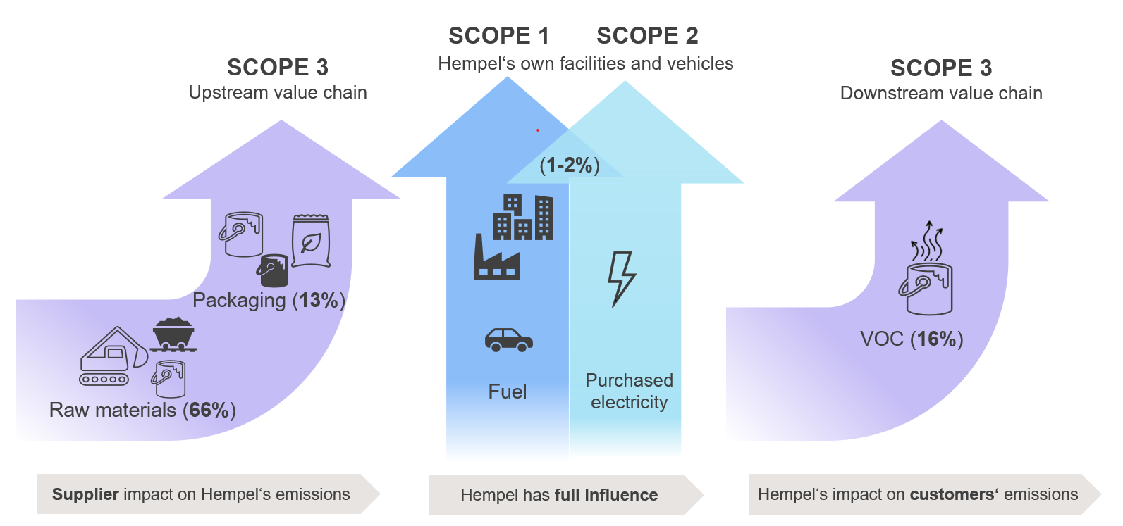
Hempel has sector-leading Science-based Targets
2019 baseline
  Reduce CO₂e emissions from our own operations by 90% by end of 2026
  Reduce CO₂e emissions from our value chain by 50% by end of 2030
Main part of our emissions are under procurements influence….
Logistics (4%)
Logistics (1%)

Slide 5

Challenge: Data are imperfect, but we need to act now

Slide 6
2020: Figuring out how to approach climate action in the supply chain
How to move from tick the box questionnaires to dialogue and engagement?
How can we understand the sustainability challenges and opportunities for each of our different categories?
How can we implement sustainability into tenders?
How can we make sustainability data driven when only poor data exist?
How can we engage with suppliers with very different maturity levels?
Some of the questions we asked ourselves

Slide 7
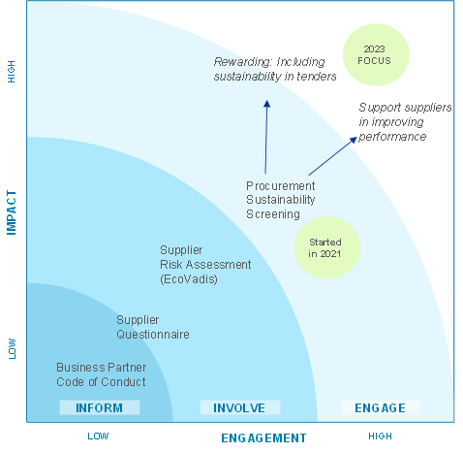


Our solution:
Supplier screening process to focus on engagement
Procurement Sustainability Screening launched in 2021 to drive positive impact in our upstream value chain
Focus on understanding drivers of environmental sustainability
Establish suppliers’ maturity (rather than only current emissions data)
Commercial impact from 2023
KPI: 70% spend coverage by 2025

Slide 8
The questionnaire is designed to encourage dialogue and development
Questionnaire covers key sustainability topics
Focus on:
Strategy
Initiatives / targets
Product data and opportunities
Data transparency
Value chain

Slide 9
Questionnaire content
 | TOPICS | DATA | DOCUMENTATION
Company information | Contacts for sustainability Services to Hempel General sustainability assessments | Production facilities % share of total production Assessment score and validity | Ethical Policy/ Guidelines Sustainability assessments/scorecards
Sustainability in your company | Strategy, focus areas and goals Participation in external sustainability initiatives | Carbon emissions data | Sustainability strategy Carbon reduction targets
Products | Sustainability monitoring (products) Environmental criteria Sustainable solutions |  | Product Carbon Footprint
Energy | Monitoring of energy consumption Energy management at facilities Goals for reducing energy consumption CO2-neutral energy – current and plans Initiatives for more sustainable energy sources | Electricity consumption total and per site (kWh per volume product) Share renewable energy ISO50001 certifications | Energy Management certification(s)
Waste | Waste monitoring and treatment methods Waste water treatment Goals and initiatives for reducing waste | Waste per treatment method (kg per volume product) total and per site
Transport | Transportation modes - outbound logistics Carbon emission Opportunities for sustainable transport | Transportation modes % of total outbound transport CO2e from outbound logistics (total and Hempel)
Sustainable supplier management | Supplier qualification and evaluation Supplier follow-up |  | Suppliers Code of Conduct

Slide 10
It is a dialogue intensive process, also involving the procurement team

Slide 11
Learnings: How to make meetings impactful
Take time to explain the WHY: It is not just a screening
Get the right participants: Build a bridge between “commercial” and “sustainability”
  Include the right people mix – like category managers, product experts, environmental specialists
Be humble: “We need to understand and you are the experts”
Be clear about the business case: Sustainability equals commercial value
Be willing to help: Don’t worry, not all will ask..
Be open about challenges: We learn together
Set the meetings up for an open exchange on strategy, market perspectives, product opportunities
Explore opportunities – don’t just set a score
Notes:
The meetings take different

Slide 12
The company scorecard is our feedback to suppliers and a tool for continuous development
Benchmark
Comparison with industry/category peers
Maturity assessment
Maturity and profile to compare with the peer group
Understanding supplier sustainability
Summary of strengths and improvement opportunities is basis for follow-up and dialogue.

Slide 13

The performance review ensures regular update on sustainability metrics to category managers
Latest data
Both Screening and EcoVadis
Identifies low performance
Corrective actions with low performers helps prioritize
Basis for category strategy
“Category score” is spend-weighted

Slide 14
Learnings: Challenges and opportunities
New collaboration opportunities
No, thank you
Lack of transparency
Procurement as a change agent
Sustainable product opportunities
Lack of skills / competencies

Slide 15
Stepping up in 2024
From engagement to impact
Next step on the journey: IMPACT
Set clear expectations to suppliers on sustainability
Set targets to improve sustainability performance in categories
Empower and train procurement team
Procurement Sustainability Screening launched
Target to screen 70% of total spend by 2025
Sustainable Procurement Policy established
Follow up of low performing suppliers started
First pilot of sustainability in tenders
Risk review launched
June
2021
Oct
2022
December
2022
May
2023
Dec
2023
Dec
2020
March
2021
March
2022
April
2022
April
2023
Realizing scope 3 reduction opportunities
New legislation on sustainability focuses on reporting and due diligence in the value chain
Double Impact
Sustainability part of Hempel’s strategy for the first time
Science Based Targets
Hempel commits to most ambitious climate targets in our industry
Sustainability linked loan agreement
Hempel links EUR 1.5 billion credit facilities to sustainability targets
A rating Supplier Engagement
Carbon Disclosure Project gives Hempel an A rating for leading Supplier Engagement practice
FutureProof
Sustainability framework launched

Slide 16
Thank you
Dagny Nome,
Procurement Sustainability Manager e-mail: DAGN@hempel.com

