Slide 1

Supplier engagement &
data methodology journey
Pfizer
Maria Terracina
London, Jan 24-25 2024
Information in this presentation is provided as an example of Pfizer’s climate actions. This presentation is not a recommendation for appropriate actions for other companies.

Slide 2
Anti-trust guidelines
Discussions focused on sustainability matters are not exempt from antitrust laws. These discussions are not intended to reduce competition or create anticompetitive effects. Attendees may not share competitively sensitive information, including information concerning pricing, margin, volume, cost or business strategy. In addition, attendees may not discuss collective action to limit dealings with any industry participant. Agreements among competitors to fix prices or output, rig bids, or share or divide markets by allocating customers, suppliers, territories, or lines of commerce are illegal under competition laws. Agreements among competitors and industry participants to boycott or refrain from doing business with certain companies can also give rise to liability under competition laws.

Slide 3
Pfizer’s progress
Pfizer’s commitment spans more than 20 years, and we are continuing to scale our ambitions
…to 2022
> 60%
reduction in Scope 1 & 2 GHG emissions from 2000 baseline
29%
Suppliers by Spend have/committed to develop GHG emissions reductions targets approved by SBTi
A- (Leadership)
score in CDP climate change response
~Approx 50%
Colleagues with ESG KPIs factored into their compensation
2015…
1st
Pharmaceutical company to seek and gain approval of its greenhouse gas emissions reduction goal from the Science Based Targets initiative (SBTi)

Slide 4

Reaching Net Zero will require longer-term, scaled action, working in parallel on Supplier Engagement and Data emissions reporting
We have created a management system framework around 5 key components:
Our supplier engagement approach will be agile and iterative:
Collaborate
Utilize tailored approaches to engage suppliers
Differentiate
Scale supplier collaboration across Pharma to drive ambitious goals
Segment
Prioritize the most impactful initiatives and suppliers to engage
Action
Operating model
Embed sustainability across the procurement organization
Employee engagement & empowerment
Upskill & activate the wider network
Supplier engagement & capability building
Collaborate with suppliers
Drill down on supplier engagement capability building
Enablers
Data methodology collection
Define our carbon reduction strategy
Technology enablement
Scalable digital solution

Slide 5
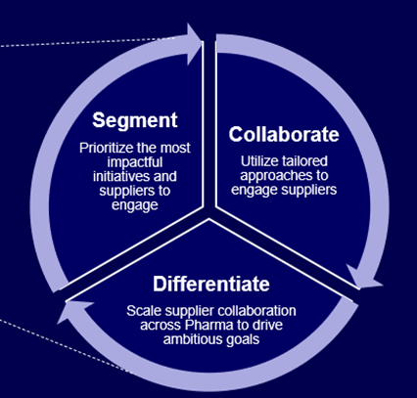
Shifting from estimating emissions using spend data to collecting actual emission data from suppliers
Implementing a single comprehensive technology solution to measure, track and manage Pfizer Scope 3 Supplier emissions
Net Zero Cloud for Scope 3
Emissions calculation
Pilot supplier engagement for Top supplier using NZ Cloud
Implementation of NetZero cloud solution for spend based and activity-based supplier data collection, analysis and reporting
Data collection campaign: Engagement of 200 Suppliers gather 2022 actual GHG emissions in Q1, 2024. 2023 data collection will follow in S2
Scalable NZ Platform for GHG suppliers emissions data collection and reporting
Value for Pfizer:
Single platform for supplier GHG emissions data ingestion, validation, analytics and reporting
Provides Pfizer the ability to undertake analysis with actual supplier data driving improved focus, prioritization and investments in NZ goal achievement
Gather actual allocated emissions and reductions from Top suppliers to inform Pfizer’s Net Zero goals and progress
* Current project scope is limited to Top 200

Slide 6
THANK YOU!

