Slide 1
Navigating the Technology Landscape for Scope 3 Solutions
Miguel Cossio
Notes:
Presentation Title
Presenter's Name
Presenter's Name
Miguel’s intro and types of client interactions
1 © 2024 Gartner, Inc. and/or its affiliates. All rights reserved. Gartner is a registered trademark of Gartner, Inc. and its affiliates.

Slide 2
89% Using or Currently Searching for a Scope 3 Digital Solution
Source: Scope 3 Peer Group. Digital Solutions Landscape and Adoption Survey, Dec 2023
Notes:
Horrible landscape – new vendors, existing vendors developing new capabilities and vendors from adjacent markets all looking for a piece of the pie.
My goal for the session – Give you the insights YOU need to navigate this very confusing landscape so you can make faster, and more confident progress towards selecting a tool that will fit your needs.

Slide 3
Definitions
Supply Chain Scope 3 Emissions
1. Indirect emissions that occur in the value chain of the reporting company where Supply Chain has greatest control. 2. Primarily focused on Category 1 - purchased goods and services.
Digital Tools and Solutions
1. Software applications available in the market that enable organizations to manage their Scope 3 program. 2. Software can be on-premises applications or SaaS (Software-as-a-Service). 3. Excludes service providers (e.g. consultants, industry associations, etc.)
Notes:
Before we get started, a few definitions
Scope 3 = 15 categories. These tools are focused on Scope 3 emissions where supply chain has the greatest influence, primarily Scope 3.1 – Purchased Goods and Svcs
Tools – anyone here can go and purchase a licence

Slide 4
Today’s Agenda
What types of digital solutions are available in the market?
How can these solutions help?
How do I select the best tool for our Scope 3 program?
Notes:
Placeholder for text (substitute your own text; delete when not used)

Slide 5
What types of digital solutions are available in the market?

Slide 6
What do These Solutions Have in Common?
Notes:
Let’s start with a little quiz – open it up to the audience
BTW – picked these randomly, I am in no way endorsing any of these – some are great others not so great
Very different…but they can all help with Scope 3 albeit in VERY different ways. If you run a comparison of these 4 (which is not uncommon) you’ll have a VERY hard time comparing them

Slide 7
Solution Types Available – and How to Spot Them
Solution Type
Domain Expertise
Carbon Management Solutions
Supply chain-focused
Enterprise-focused
Scope 3
Primary focus
Value statements
Modules offered
Capabilities listed
ESG Solutions
Supply chain-focused
Enterprise-focused
Legacy Solution Suites
Embedded carbon module
Specialty Applications
Supplier collaboration
Project management
Innovation management and others
Other
Notes:
The best way to think about the solution landscape is this.
Carbon Mgmt / ESG - Talk about supply-chain focused vs enterprise focused (the nuance of it)
How to identify these (primary focus, etc)
WHY it’s important to differentiate

Slide 8
What do These Solutions Have in Common?
The carbon management solution for complex supply chains Source: Carbmee
Improve Environmental, Social and Governance (ESG) performance and risk management with integrated software, data and consulting solutions
Source: Sphera
A Single Platform to Efficiently Manage All Supplier Relationships and Spend
Source: Ivalua
Leverage the power of Supplier Collaboration & Innovation to drive sustainable business growth
Source: Vizibl
Notes:
A quick look at their websites can help you start classifying them

Slide 9
How can Digital Solutions Help?

Slide 10
Outcomes Enabled and Key Capabilities Offered
Measure
Manage
Reduce
Report
Supplier readiness
Baselining and hotspot analysis
Basic data analytics
Emissions glidepaths
Supplier capability-building
Data exports
API Integrations
Auditable data sets
Advanced
Primary data collection
Carbon calculator
Product Carbon Footprints
Scenario Modeling
Data quality indicator
Internal carbon pricing
Decarbonization levers
Project tracking and implementation
Smart workflows for standard disclosures
External stakeholder access
Notes:
All vendors, even those that are not carbon tools are looking to cover the broad spectrum of outcomes, offering basic capabilities you can see on top
However – some are now developing more advanced capabilities
////go through each set
--→ If you’re looking at all these capabilities and thinking “I want them all” I’m sorry to say <CLICK>

Slide 11
There’s no silver bullet. 55% expect to use two or more tools to manage their Scope 3 program
Source: Scope 3 Peer Group. Digital Solutions Landscape and Adoption Survey, Dec 2023
Notes:
There’s NO silver bullet

Slide 12
How to Choose a Digital Solution for Scope 3
Notes:
We now know there are different types of tools and very different capabilities being offered. The next step is – How do you choose the best solution that fits your needs?

Slide 13
Six Steps for Choosing a Solution
1
Define Outcomes and Capabilities
2
Shortlist Vendors
3
Launch an Effective RFP
4
Uncover the Truth (Demo)
5
Run Due Diligence
6
Review Commercials
Notes:
Six steps and my top recommendations
Composable arq – extensibility
Source to pay
ERP

Slide 14
Six Steps for Choosing a Solution
1
Define Outcomes and Capabilities
Shortlist Vendors
Launch an Effective RFP
Uncover the Truth (Demo)
Run Due Diligence
Review Commercials
Notes:
Many companies I speak to simply overlook this step – which is the most critical -

Slide 15
Ambition
Ambition
Oversight
&
What success looks like
Desired level of control
Oversight
Notes:
Define the outcomes you need a tool to help you with thinking about ambition and level of oversight / control you need.
Talk about extremes
---Ambition (measure to comply with regulations and customer requests VS Net Zero)
---Oversight (you have limited resources or appetite to oversee what suppliers are doing/staying on track, etc HANDS OFF. VS full visibility and tracking
Source: Getty
https://brand.gartner.com/content/index/guid/photography_library?parent=123&search_term=marathon&list_size=24&sort_order=most_recent

Slide 16
Capabilities Will Vary Across Solution Types
Strong
Average
Weak
Measure
Manage
Reduce
Report
Carbon Management Solutions
ESG Solutions
Legacy Solution Suites
Specialty Applications
Notes:
This is a generalization of what you can expect – there are (like always) exceptions
---CAM – enterprise-focused are not always great at collecting data from suppliers
---Specialty – REDUCE…..might not always have the levers to decarbonize but they enable all the infrastructure to establish closer ties with suppliers and stay on top of progress

Slide 17
Six Steps for Choosing a Solution
1
Define Outcomes and Capabilities
Based on ambition and oversight
2
Shortlist Vendors
Launch an Effective RFP
Uncover the Truth (Demo)
Run Due Diligence
Review Commercials

Slide 18
Finding the Set of Vendors to Approach
Time and Effort
1
Web search, top 10 lists, etc.
2
Internal tools and expert insights
3
Peer and supplier input
Notes:
What does the process typically look like?
Spend significantly more time on web searches, etc and not enough asking peers and suppliers
Need to flip this around

Slide 19
Prioritize Peer and Supplier Input to Shortlist Fewer and Better Vendor Options
Time and Effort
1
Peer and supplier input
2
Internal tools and expert insights
3
Web search, top 10 lists, etc.
Notes:
This will help you find fewer and vendor options that are more relevant

Slide 20
Six Steps for Choosing a Solution
1
Define Outcomes and Capabilities
Based on ambition and oversight
2
Shortlist Vendors
Prioritize peer and supplier inputs
3
Launch an Effective RFP
Uncover the Truth (Demo)
Run Due Diligence
Review Commercials
Notes:
Key word – EFFECTIVE
If you can, skip this process.
Endless companies end up spending a lto of time on very complex RFPs and once they receive their responses, they’re none the wiser.
If you feel compelled to launch an RFP <CLICK>

Slide 21
Better Questions Yield Better Answers During RFP
From
Do you help provide transparency into our Scope 3 emissions?
Can your solution help us reduce our Scope 3 carbon footprint?
Can your solution help ensure compliance to applicable laws and regulations focused on Scope 3?
Do you validate supplier data collected through the platform?
To
HOW do you help provide transparency into our Scope 3 emissions?
HOW does your solution help us reduce our carbon footprint Scope 3 emissions?
HOW does your solution help ensure compliance to applicable laws and regulations focused on Scope 3?
HOW do you validate supplier data collected through the platform?
Focus on HOW

Slide 22
Six Steps for Choosing a Solution
1
Define Outcomes and Capabilities
Based on ambition and oversight
2
Shortlist Vendors
Prioritize peer and supplier inputs
3
Launch an Effective RFP
Focus on HOW
4
Uncover the Truth (Demo)
Run Due Diligence
Review Commercials
Notes:
This is your opportunity to really see what the vendor offers.
But here’s the problem….Most companies when they ask for a demo this is the typical process <CLICK>

Slide 23
Moving Beyond Standard Demos
Company Overview
Strongest Capabilities
Why Scope 3 is Important
Standard Demo
Customer Base
Company Overview
Expertise and philosophy
Tailored Demo
Focused on desired outcomes
Time to Value
Supplier adoption and support
Relevant Customer Base
Industry, size, complexity and ambition
Notes:
Typical process
A mor effective approach is asking vendors upfront to focus on the following

Slide 24
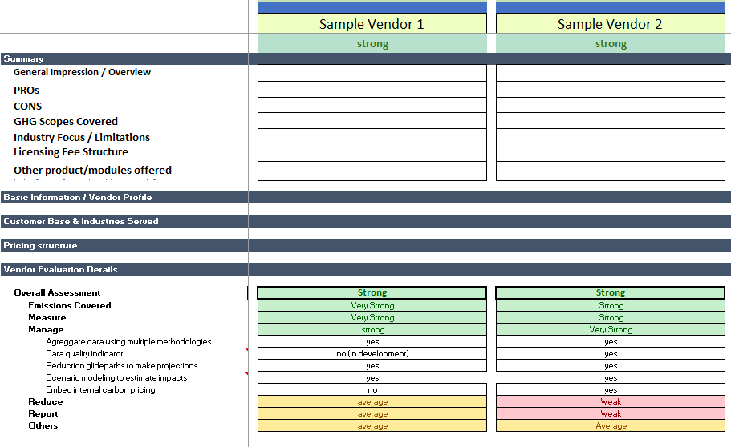
Your Digital Goodie Bag
Vendor Evaluation Matrix
Notes:
Scope 3 tools study - Oliver will share it

Slide 25
Six Steps for Choosing a Solution
1
Define Outcomes and Capabilities
Based on ambition and oversight
2
Shortlist Vendors
Prioritize peer and supplier inputs
3
Launch an Effective RFP
Focus on HOW
4
Uncover the Truth (Demo)
Take control, don’t accept canned demos
5
Run Due Diligence
Review Commercials

Slide 26
Beyond Tool Features: Key Elements to Assess
Digital Solution
Functional capabilities
Technical requirements
Program support
Suppliers currently in network
Supplier experience and adoption
Company Profile
Financial Health
Executive leadership background
Industry focus and customer base
Years in the market
Product strategy and roadmap
Vendor Evaluation
Notes:
Most will focus on the Digital solution itself such as….
We also have to pay close attention to the company profile.
--- dynamic market. Lots of new players, starting to see some M&A, etc
--- adjust based on your risk appetite, your desire to influence product roadmaps, etc

Slide 27
Six Steps for Choosing a Solution
1
Define Outcomes and Capabilities
Based on ambition and oversight
2
Shortlist Vendors
Prioritize peer and supplier inputs
3
Launch an Effective RFP
Focus on HOW
4
Uncover the Truth (Demo)
Take control, don’t accept canned demos
5
Run Due Diligence
Go beyond tool features
6
Review Commercials

Slide 28
Uncover Hidden Costs Upfront to Avoid Surprises
Waterline of Visibility
Subscription Fees
# suppliers
Training
Integrations
Supplier support
Up to 50% of total costs!
Data Validation
User seats
Customization
Etc.
Notes:
Our research shows that these hidden costs can be up to 50% of total costs
Ensure they address the relevant things listed here
Even if they include some of these, ask about changes – EG. # of suppliers quoted…what happens if we want to grow the program?

Slide 29
Six Steps for Choosing a Solution
1
Define Outcomes and Capabilities
Based on ambition and oversight
2
Shortlist Vendors
Prioritize peer and supplier inputs
3
Launch an Effective RFP
Focus on HOW
4
Uncover the Truth (Demo)
Take control, don’t accept canned demos
5
Run Due Diligence
Go beyond tool features
6
Review Commercials
Uncover Total Cost of Ownership (TCO)
Notes:
There you have it. Specific insights to help you navigate the tech landscape.
Composable arq – extensibility
Source to pay
ERP

Slide 30
Questions? Miguel.cossio@gartner.com
Notes:
Placeholder for text (substitute your own text; delete when not used)

