Slide 1


Sustainable Procurement

Slide 2
Procurement: CBRE supply chain decarbonization
Market gap: Not enough suppliers have started their decarbonization journey
~2% actively decarbonising
Early value chain engagement is key in enabling the procurement Net Zero pathway
~8% Intermediate
Limited progress in first years as 50-70% of suppliers have very low Sustainability capabilities, and will need time to develop
~30%
Beginners
Delays in supply chain decarbonization can be costly as supplier journeys are difficult to compress
CBRE Supplier Base Maturity
~60%
Zero experience
Requires consistent reductions across the entire supply chain of over 10% YOY from 2026
CBRE target:
68% reduction on 2019 baseline by 2035
2019
2022
2026
2030
2035
2040
Source: Emissions data from 2019-2022 CBRE WIOD supply chain emissions inventory, data from 2023 onwards modelled
Source: market observations from EcoVadis & CDP

Slide 3
Decoupling business growth from emissions
By evolving in methodologies, you unlock the decoupling of emissions from business growth.
net zero supply chain
Business growth
Emissions reductions
Emissions calculation methodologies
    Supplier specific method: product-level GHG inventory data suppliers
Evolved state
    Hybrid method: Emissions data from suppliers and, if there are gaps, using extrapolated data
Accuracy
    Average data method: Utilization of volume and data associated with product emissions
Business growth
    Spend based method: utilization of industry emissions factors multiplied by spend
Emissions growth
Typical state
    Extrapolation of emissions based on similar category spend and emissions data.
Emissions Accuracy model: UK Green Building Council, Scope 3 Guide for Commercial Real Estate
This is a challenge for supply chain decarbonization as it is a dead-end process.
Notes:
Talk track:
Because tracking and reporting emissions is complex, most companies tend to use low complexity methodologies, which also means low accuracy of emissions along the supply chain. Our NZSC leverages higher accuracy methodologies which yields the benefit of being able to decouple business growth from emissions growth.
CBRE gleaned this insight by taking measures to manage our own holistic supply chain decarbonization challenges.

Slide 4
That which gets measured gets managed
Net zero supply chain
Challenges with current supply chains
Solved by Net Zero Supply Chain
Limited ability to understand emissions hot spots
Deep knowledge of most emitting suppliers and difficult-to-abate inputs
Engage your CRE suppliers to calculate, report, and reduce emissions to achieve a Net Zero Supply Chain.
Limited influence over supplier’s emissions and practices
Collaboration on joint emissions reduction initiatives
Net Zero Supply Chain provides the ability to focus precious resources on the most effective and impactful decarbonization initiatives.
Ill-equipped and ESG-fatigued suppliers
Suppliers equipped with tools to accurately track and reduce emissions
Lack of data transparency, constantly hit by escalations and crisis
High visibility and increased supply chain resilience
Notes:
Talk track:
CBRE faced these challenges and designed NZSC to solve for it. Now we’re able to share the benefits of our learning with our clients.

Slide 5
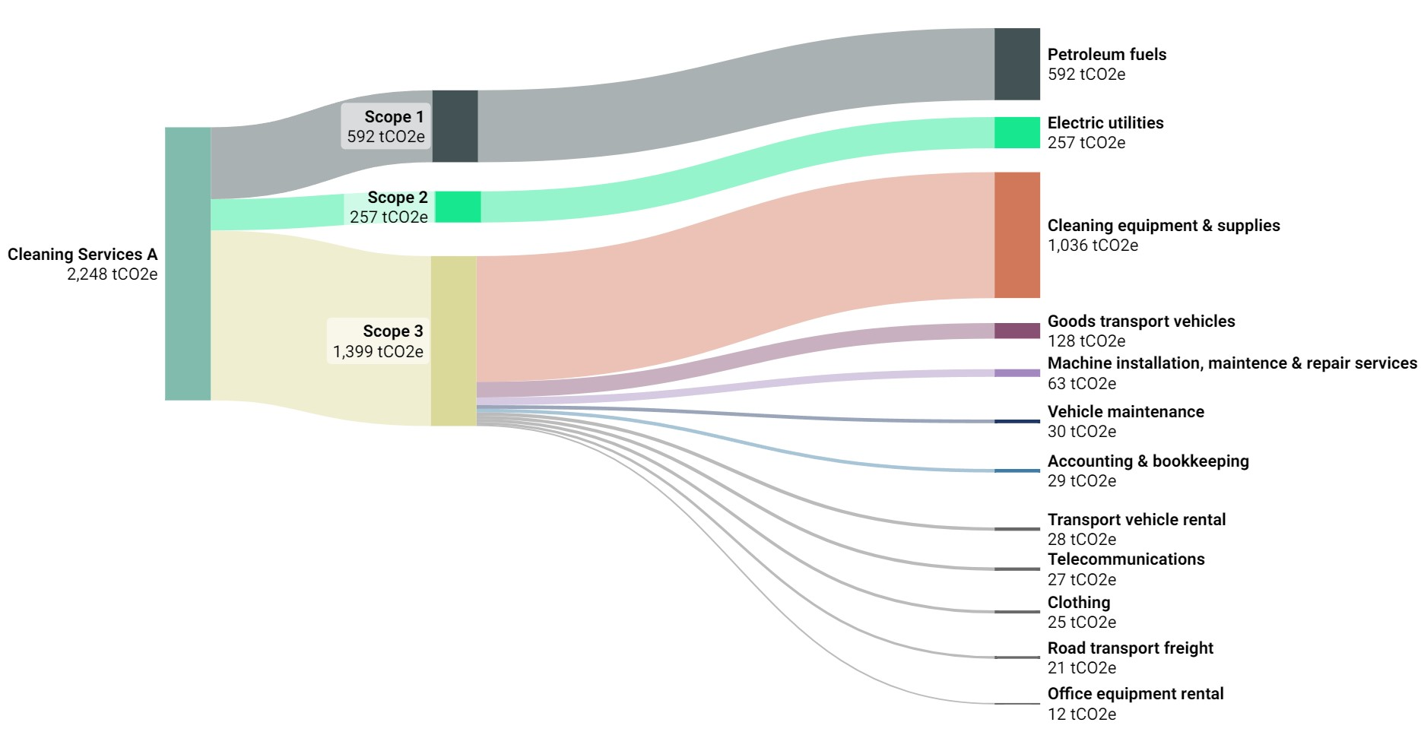
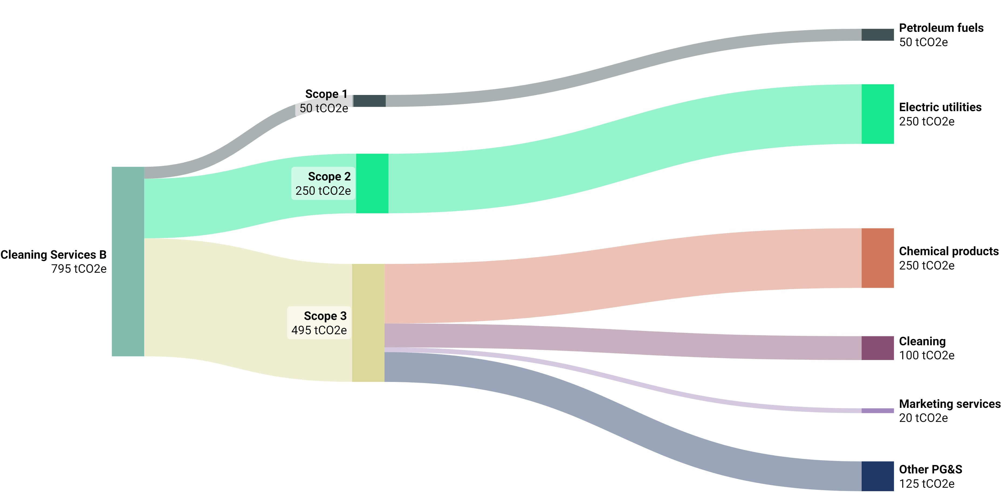
Real data creates the roadmap
NET Zero supply chain
Example - Compare actual emissions data from two janitorial companies
Janitorial Company A:
Emissions intensity factor 0.0838 tCO₂e/$k
Company A’s emissions factor is three times higher than Company B.
Recommend: Work with Company A to reduce emissions and switch to Company B for all new sites.
Janitorial Company B:
Emissions intensity factor 0.0277 tCO₂e/$k

Slide 6
Thank you.
Mat Langley
Global Procurement Head, ESG
mat.langley@cbre.com.sg
Alexandra Delval
VP Supplier Sustainability
Alexandra.delval@cbre.com
CBRE © 2022 All Rights Reserved. All information included in this letter/proposal pertaining to CBRE, Inc. (“CBRE”)—including but not limited to its operations, employees, technology and clients—is proprietary and confidential and supplied with the understanding that such information will be held in confidence and not disclosed to any third party without CBRE’s prior written consent. This letter/proposal is intended solely as a preliminary expression of general intentions, is for discussion purposes only, and does not create any agreement or obligation by CBRE to negotiate or continue negotiations. CBRE shall have no contractual obligation with respect to the matters referred to herein unless and until a definitive, fully-executed agreement has been delivered by the parties. Prior to delivery of a definitive executed agreement, and without any liability to the other party, either party may (1) propose different terms from those summarized herein, (2) enter into negotiations with other parties and/or (3) unilaterally terminate all negotiations with the other party hereto. CBRE and the CBRE logo are service marks of CBRE, Inc. All other marks displayed on this document are the property of their respective owners, and the use of such logos does not imply any affiliation with or endorsement of CBRE.
Robin Burton
Director, Global ESG Procurement
robin.burton@cbre.com

Slide 7

Decarbonisation pillar
Supplier Sustainability
Supplier Sustainability Program
Related program
Sustainability governance
Net Zero Supply Chain
Circularity
Supplier ESG risk monitoring | Supplier Sustainability Assessments |  | Measure and reduce emissions | Net Zero Supply Chain product |  | Use less Buy better
Strategy focused on following suppliers:
Strategic
Preferred
Key Approved
Diverse
Client specific projects
Carbon Trace powered by Emitwise
Supplier engagement
Supply chain capability building
Decarbonisation insights
Net Zero Supply Chain product
Corporate Real Estate emissions
Measurement
Strategy
Transition

Slide 8
Net Zero Pathways
CBRE Net Zero Strategy
  Buildings
  Transport
  Energy
  Procurement
  Strategic Objectives
      Continuously improve energy efficiency and reduce resource use across our corporate offices
      Support sustainable office site development
      Advance corporate office water stewardship
      Manage corporate office materials with a circular economy approach
  Strategic Objectives
      Electrify vehicle and equipment fleets
      Minimize the carbon impact of business travel
      Encourage employees to reduce the carbon impact of their commute
  Strategic Objectives
      Improve energy data collection and accuracy across our corporate offices
      Purchase 100% renewable energy for corporate offices by end of 2025
  Strategic Objectives
      Build capability with suppliers to share reliable primary GHG emissions data
      Prioritize strategic engagement with select suppliers to influence the greatest potential carbon impact to meet net zero commitments
      Integrate net zero requirements into procurement standards to influence systemic change
      Expand the reach of impact by developing supplier decarbonization capabilities

Slide 9
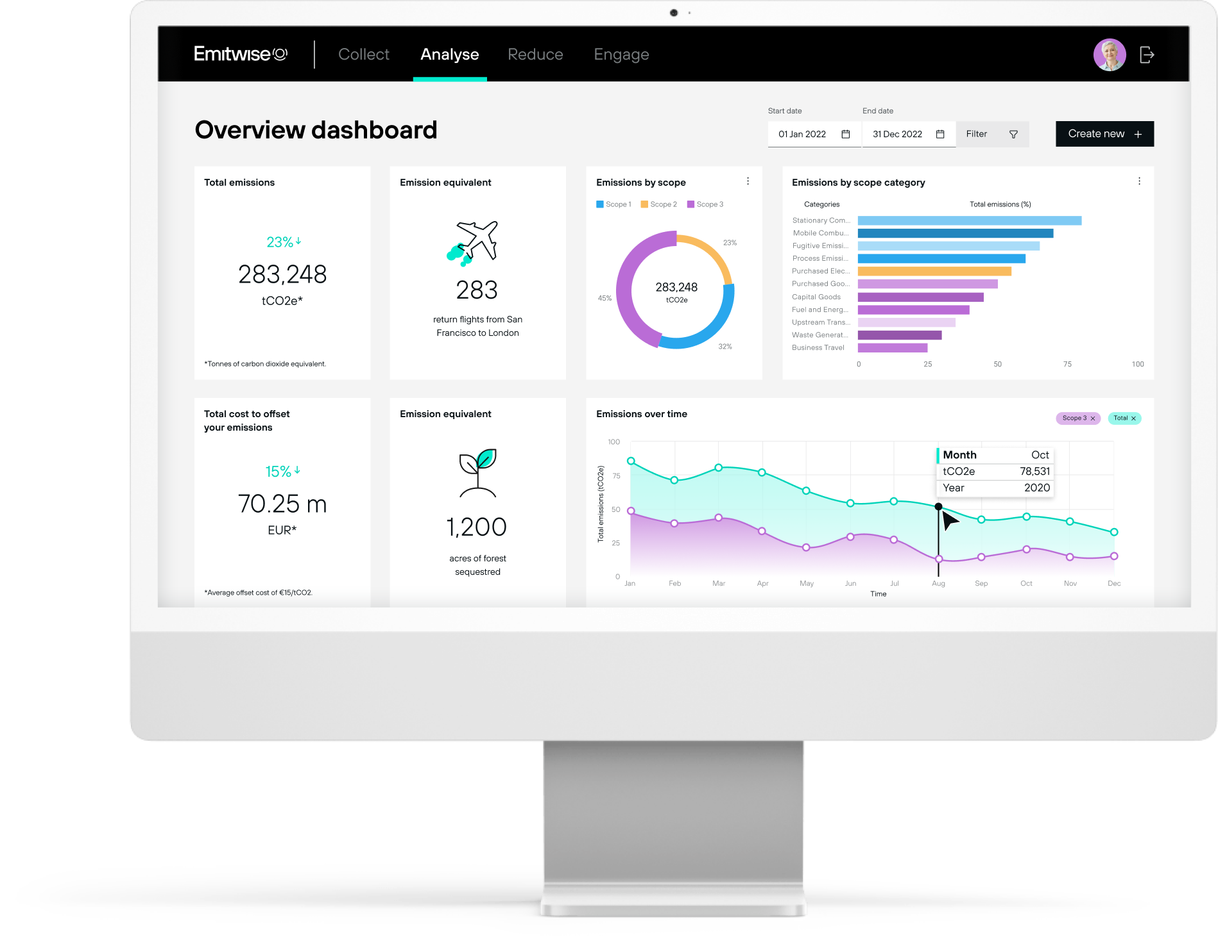
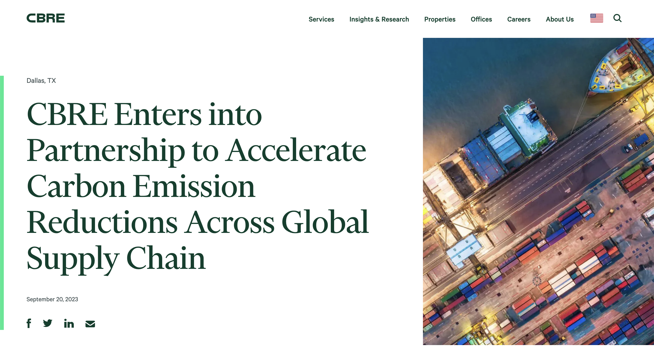


CBRE’s partnership with Emitwise
Net zero supply chain
CBRE’s own multi-year journey has led us to make a strategic investment to secure unique carbon management capabilities along our supply chain.
Benefits of strategic investment:
First time CBRE has invested in a procurement technology and early-stage start-up
Our investment ensures strategic alignment on supply chain decarbonization program
CBRE gains ability to use data products early with the opportunity to pass benefits on to clients
Link to CBRE press release

Slide 10





Carbon Trace: CBRE’s supplier engagement program
Meeting suppliers where they are along their own supply chain emissions management maturity journey
  Screen
  Engage & Collect
  Evaluate
  Act
  Calculate
      We identify publicly available information about suppliers’ targets and disclosure to tailor the engagement process
      Suppliers submit emissions, targets and reduction initiatives to Carbon Trace via Emitwise.
      Emitwise calculates supplier-specific values following a consistent methodology:
      emissions intensity factor
      data quality score
      CBRE uses data to: Track progress to Net Zero, identify suppliers with confirmed low emissions, collaborate on supplier emissions reduction initiatives, and more.
      Suppliers use data to: Identify emission hotspots and reduction opportunities; verify performance against industry benchmark.
      Selected CBRE suppliers are offered a zero-cost opportunity to calculate Scope 1, 2 and 3 emissions with Emitwise.

Slide 11




Information gathered from suppliers
carbon Trace data participation requirements
A few data points will yield valuable results and insight into supplier emission maturity and hotspot analysis.
  Commitments
  Purchase data
  Initiatives
      Emissions, reduction targets and supporting evidence
      Money the company spent on goods and services
      Ongoing or planned emissions reduction initiatives
What is the data?
More than 50% of participating suppliers submit purchase data
      Supplier sustainability teams or the C-suite
      Supplier finance or procurement teams
      Supplier sustainability teams or HSE teams
Who holds the information?
Notes:
Talk track:
One of the key reasons CBRE invested in having a third party involved in Carbon Trace is that we need to access granular company activity data to derive the higher quality of emissions information. This data is too sensitive for CBRE to collect directly from our suppliers, so our partneriship with Emitwise enables a thrid party to gather and manage the most sensitive informatoin and sharing only relevant supplier-specific emissions intensity informatin with CBRE.

Slide 12
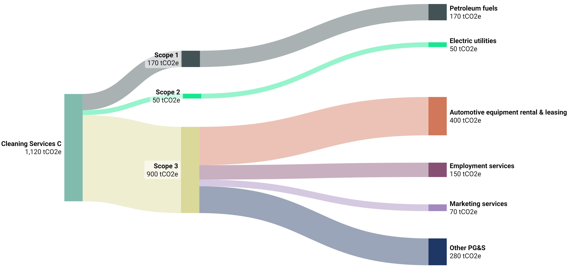
Real data creates the roadmap
Supplier-specific data will unlock the roadmap for decarbonization. Without calculating their supply chain emissions, these three companies, all working in the same sector might have all been focusing on the wrong decarbonization priorities
DATA
Janitorial Company A: Emissions intensity factor 0.0000838 tCO₂e/$
Janitorial Company B: Emissions intensity 0.0000277 tCO₂e/$
Janitorial Company C: Emissions intensity 0.0000810 tCO₂e/$
Three suppliers in the same FM service category (janitorial) and operating in the same market
RECOMMENDATION
Lower carbon emissions by considering a service provider change from Company A, to Company B for all ‘new sites’ and then co-develop a strategy with Company A to reduce emissions.
ACTION
Leverage CBRE’s Procurement Expertise to negotiate a new contract with Company B, while working with CBRE’s sustainability experts and Company A to identify environmentally friendly cleaning supplies which will reduce their carbon footprint without compromising service quality.

Slide 13
25-45%
    CBRE recorded a decrease of 25-45% compared to previously estimated supply chain emissions baseline based on industry emissions factors by collecting primary emissions data from suppliers.
    Based on a 2022/23 CBRE NZSC program, corrected for outliers
7 weeks
    Over 50% of suppliers participating in this program respond with granular primary data within seven weeks.
Carbon Trace 2023 YTD campaign impact results
55%
of participating suppliers benefitted from CBRE’s offer of capability building.
80%
were calculating Scope 3 emissions for the first time.
Balancing the supplier collaboration journey with the data accuracy journey drives significant impacts.
Participating suppliers represented over 350’000 tCO₂e in CBRE’s supply chain
1/3 suppliers reported to be actively decarbonizing, with still the majority needing support

Slide 14


Supply chain decarbonization: a continuous improvement cycle
NET ZERo supply chain
Engage & Collect
Calculate / Evaluate
Screen
Act
Screen suppliers to understand maturity
Engage suppliers through data collection campaign
Automated data
processing creating
supplier emissions factors
Rich insights and reporting
Continuously improving blend of supplier-specific data and factor-based estimates
Powered by
Emissions reduction strategy
Driving emissions data improvements and reductions
Spend based methodology for tail spend
Data gap identification
Targeted requests for material supplier-specific data
Emission reduction opportunities
Supplier engagement leading to Scope 3 improvement
Notes:
Talk track:
The focus on continuous improvement provides the ability to focus precious resources on the most effective and impactful decarbonization initiatives.
Continuous improvement is one of the fundamentals engrained in sustainable management practices.

Slide 15

Value CBRE can provide
NET Zero supply chain
CBRE’s partnership with Emitwise enables us to access granular supplier data to derive a higher quality of emissions information. It also provides a standardized and automated emission calculation methodology along our supply chain, mitigating human error.
Transparent
Emissions Data
Scalable Collaboration
Best-in-class practices, collaboration, and engagement with our supplier network at scale, driving results and accelerating progress towards your targets.
Active Emissions Removal
CBRE’s ability to execute a tangible roadmap, uncovering pathways and easing decision-making to remove emissions, influencing your commercial real estate suppliers, and improving resiliency.
Building retrofit projects:
~$2’000-10’000K /tCO₂e
Supply chain decarbonization projects:
~$100-250 /tCO₂e
Removing supply chain emissions at a lower cost per ton and with less complexity and risk, compared to Scopes 1 and 2, while also having to purchase fewer offsets* leads to overall cost savings in reaching your net zero goals.
Measurable Cost Savings
(*) In Net Zero standard, offsets are only applicable to 10% of overall emissions

Slide 16












CBRE’s Supply Chain Emissions Tool - Market Overview
35+ Carbon Accounting and Scope 3.1 measurement Solutions
Emerging AI-centric players; Relatively new decarbonization centric players; Reputation/ legacy players
Challenges
Desired outputs
Scale:
~7’500 suppliers create 90% of CBRE’s supply chain emissions
Market and RFP considerations:
Functionality
Network – What is its existing network effect and potential?
Cost
Customer Service - transparent in methodologies and willing adapt?
Implementation
Matching suppliers varied maturity
Continuous improvement
Target timelines:
7 years to halve emissions
Measuring emissions directly from suppliers
Reducing emissions by engaging early
9 included in the RFP
Data reliability:
Quality and auditability of inputs and outputs
Reliable, repeatable & comparable data
Prepare for third party verifications
4 involved in demonstrations
Completed proof of concepts
Proof of Concept requirements:
Spend Cube – ability to ingest and analyse our emissions using spend based methodologies
Identify hot spots and material suppliers
Supplier engagement – successfully engage, collect (scrape if available), calculate actual emissions (using primary data)
Recalibration of baseline and insights
Complex collaboration:
Multiple tiers of suppliers, differing methodology
Industry-agnostic solution
Network effect to maximize impact
Notes:
Key messages: Not many companies in the world have a supply chain scale issue similar to CBRE, we are among the few who need to think systematically at this scale

Slide 17
Carbon Trace deployment
Implementation progress
Lessons learned
Challenges ahead
Carbon Trace enabled CBRE to report full supply chain emissions in 2022 Corporate Responsibility Report
Finalised commercial partnership with Emitwise in Q1
Goal for 2023: engage with 1’000 suppliers
Kicked off Batch 1 supplier engagement in Q2, engaging 325 suppliers
Need to engage with 675 more suppliers in remaining 5 months of 2023 to meet goal; stretch but possible.
Supplier engagement and response metrics improved in Batch 1 over CBRE pilot phase
Even big, mature suppliers can get supply chain emissions wrong. Adopting a “trust but confirm” approach enables data quality grades.
Access to primary emissions data from suppliers is the only way to decouple emissions growth from business growth
You can’t fully subcontract supply chain decarbonization: the organization needs to retain an active role in messaging to suppliers why supply chain decarbonisation is important to them and holding suppliers accountable
Finding balance between “carrot” and “stick’ approach to supplier relationship management is important but complex, requires effective multi-stakeholder coordination, underpinned by effective collaboration tools
Suppliers are willing and grateful to take up offers to improve their capabilities, regardless of their size
Marathon: Supplier ability to improve decarbonization is a 5+year journey
Emissions baselines will evolve. Much education is needed along the value chain to enable full understanding and maintain motivation to tackle decarbonization
Evolving regulations and standards adding complexity to decisions around processes such as emissions allocation methodologies
Economic uncertainty limiting resources available to support sustainability initiatives along the value chain
ESG supplier fatigue & greenhushing

